Slide 1

ELIXIR DOCUMENTATION

Slide 2
Steps on how to create an activity

Slide 3
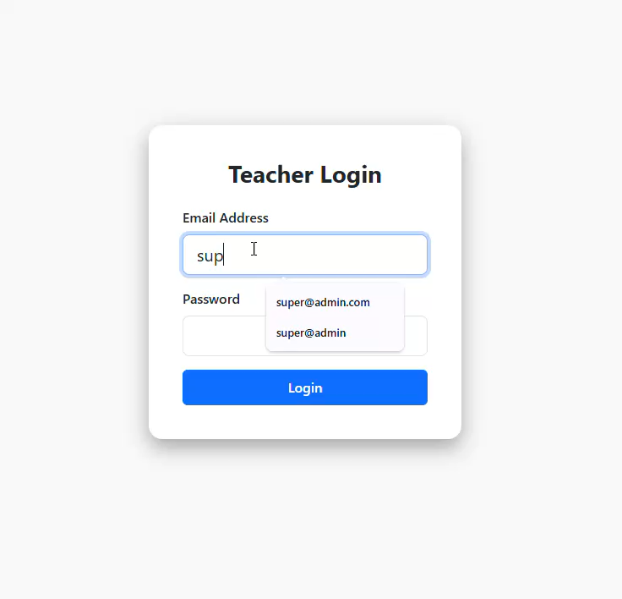
Login http://elixir.test for local machine

Slide 4
Login http://your_ip_address for remote machine

Slide 5
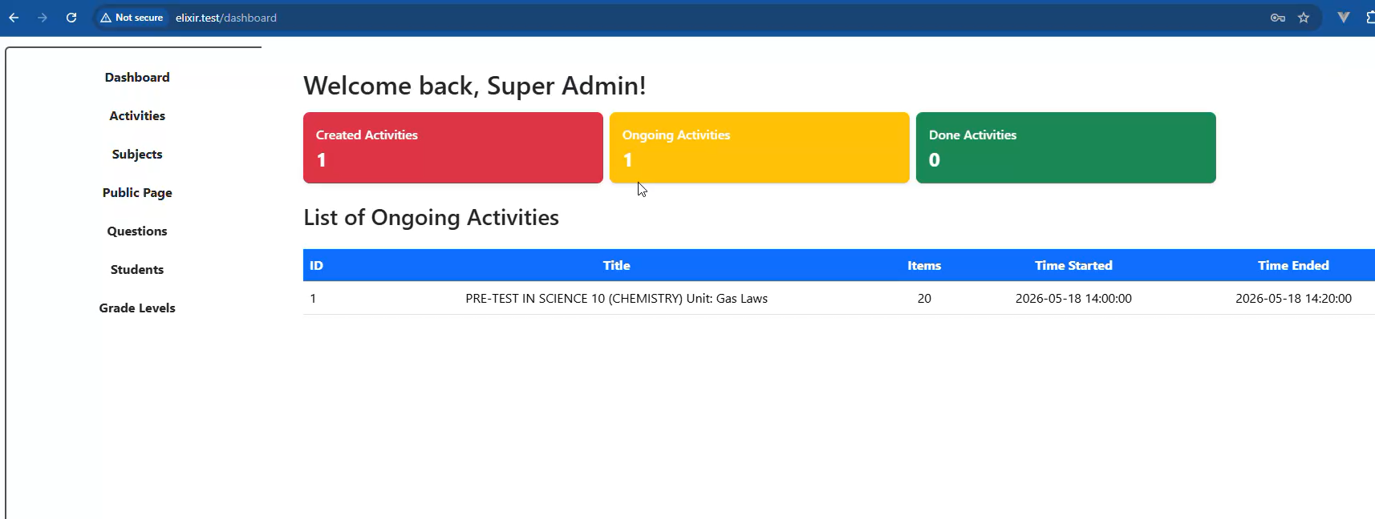
1. Click and go to Subjects page

Slide 6
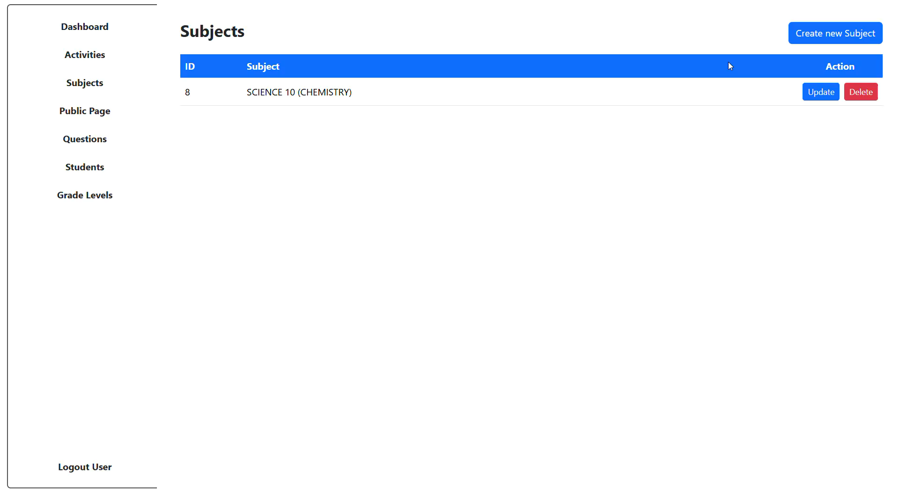
2. Create a subject
1. Create new subject

